Slide 1
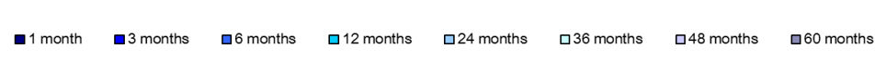
Correlation of Most Stock Market Sectors with Broad Stock Market Returns Increases with Longer Investment Horizons
Source: NAREIT® analysis of monthly returns data for January 1990 through October 2013 from Interactive Data Pricing and Reference Data accessed through FactSet.

